Slide 1
Improving Passenger Experience Through Data-Driven Insights
Created By : Chitramoy Mukherjee
DSC-640 T301

Slide 2
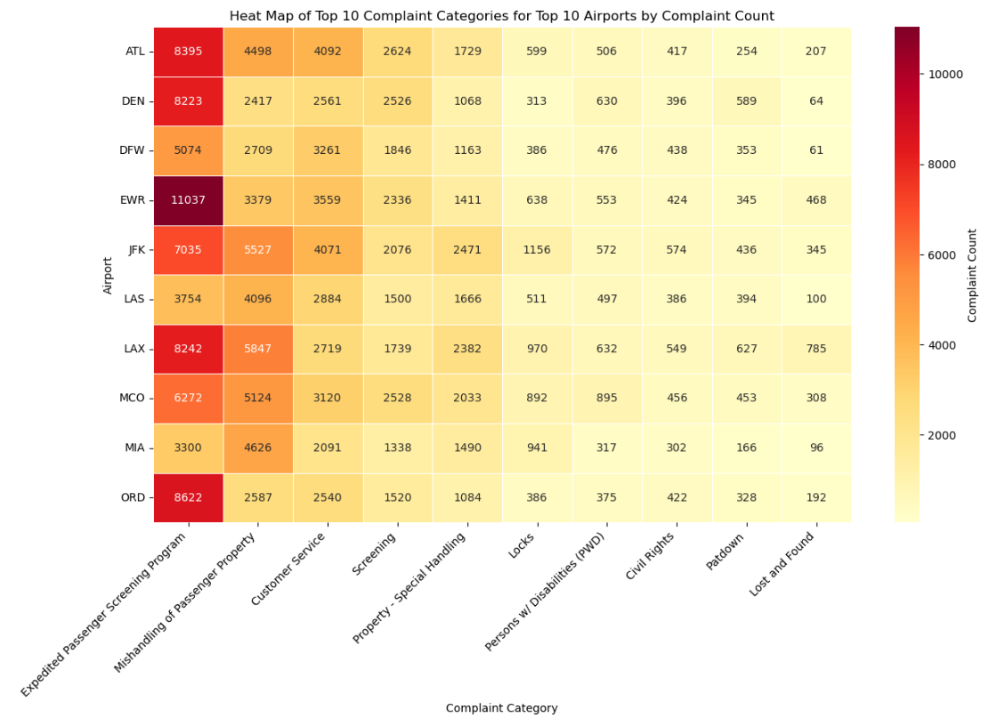
Top 10 complaints by categories for Top 10 Airports by complaint count Visualization Type: Heat Map Data Source : complaints-by-category.xlsx
Heatmap Interpretation:
Color Intensity: Warmer colors (reds and oranges) represent higher complaint counts, making it easy to spot the most frequent issues.
Airports and Categories: Each row represents an airport, and each column represents a complaint category, providing a visual comparison across both dimensions.
Insights:
This heatmap can reveal patterns in customer complaints specific to airports, such as consistent issues with certain facilities or services.
Decision-makers can use these insights to focus on improving specific services at airports where certain complaint categories are prevalent, which can directly enhance passenger satisfaction.
Call to Action:
Based on this visualization, prioritize addressing the highest-complaint categories at top airports. This targeted improvement approach can help improve the passenger experience by focusing on the most impactful areas.

Slide 3
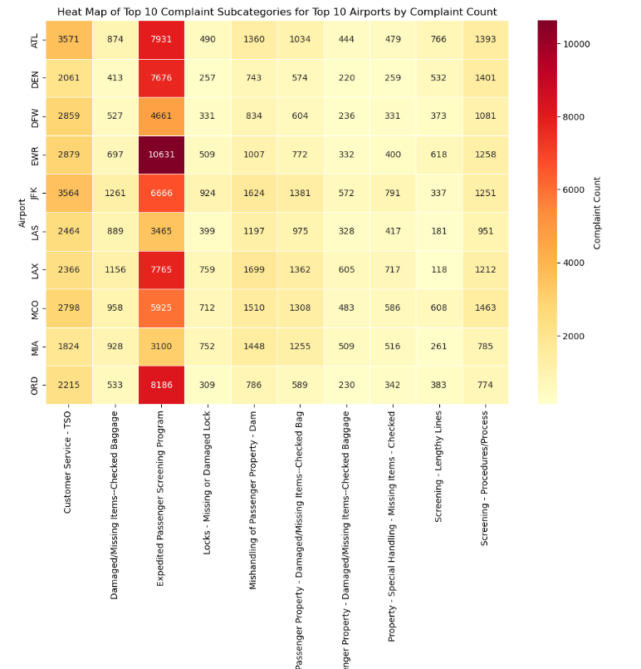
Top 10 complaints by Subcategories for Top 10 Airports by complaint count Visualization Type: Heat Map Data Source : complaints-by-subcategory.xlsx
Focusing on Top Complaint Subcategories:
The dataset is then filtered to include only complaints for the top 10 airports.
Next, it groups these complaints by subcategory to identify the top 10 complaint subcategories across these airports, isolating the most frequent types of complaints.
Heatmap Visualization:
A heatmap is created to visually represent this data. Using color intensities, the heatmap quickly highlights airports and subcategories with the highest complaint volumes.
The title, axis labels, and color bar improve clarity, making it easy to compare complaint types and frequencies across airports.
This heatmap clearly illustrates which complaint subcategories are most prevalent at the top 10 airports with the highest complaint counts. The findings could help prioritize targeted improvements in passenger experience, especially for areas with high complaint concentrations.

Slide 4
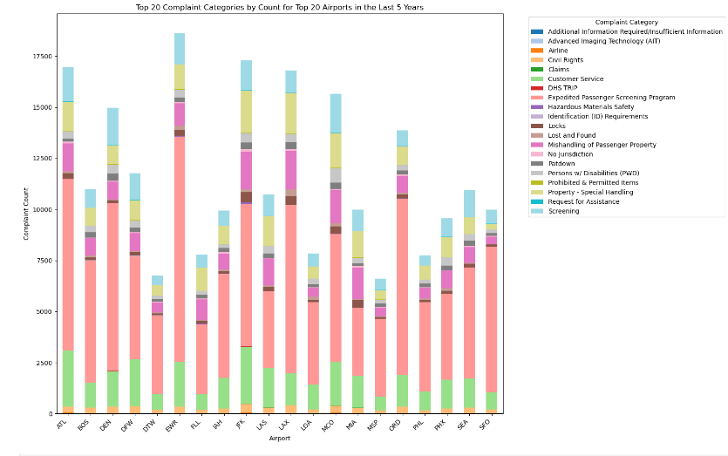
Top 20 complaints categories by count for Top 20 airport Visualization Type: Stcked bar chart Data Source : complaints-by-category.xlsx
This stacked bar chart provides a comprehensive overview of the top 20 complaint categories by count across the top 20 airports in the last five years. Each bar represents an airport, segmented by various complaint categories. Here’s a breakdown of key insights:
Top Complaint Categories: The color-coded segments within each bar indicate the volume of specific complaint categories, allowing stakeholders to quickly identify the most common complaint types at each airport.
Airport-Specific Complaint Trends: The stacked design helps highlight unique complaint patterns for each airport, making it easy to see which airports have a high volume of specific issues (e.g., delays, customer service) compared to others.
Focus for Improvement: Airports with larger bars indicate higher overall complaint volumes, highlighting where intervention might have the biggest impact. The visibility of category-specific complaints also enables targeted strategies, such as addressing prevalent issues like baggage handling or security wait times.
Comparative Analysis: Airports can be compared side-by-side to identify whether certain complaint types are more prominent in specific locations, providing actionable insights for airport management and policymakers.
This visualization offers an actionable summary, aiding in the identification of high-impact areas for enhancing passenger satisfaction and operational efficiency at major airports.

Slide 5
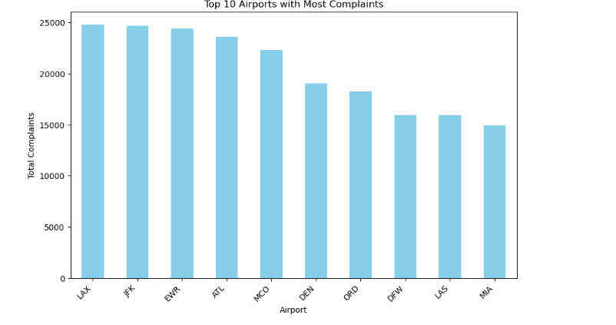
Top 10 airports with most complaints Visualization Type: bar plot Data Source : complaints-by-airport.xlsx
Interpretation of the Outcome:
The bar plot visually highlights the airports with the highest complaint volumes, making it easy to identify which locations have the greatest number of reported issues.
This information could be valuable in directing resources, identifying high-priority airports for operational improvements, and addressing common concerns impacting passenger experience.
This bar chart provides a concise summary of the top 10 airports with the most complaints, making it a strong visual tool for presenting insights to stakeholders. It can help stakeholders quickly identify priority areas for improving airport services and addressing common passenger concerns.

Slide 6
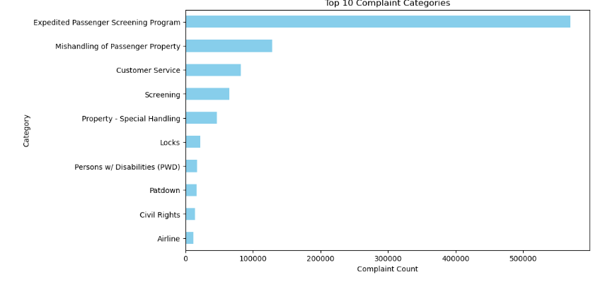
Top 10 complaints Categories Visualization Type: Custom bar chart Data Source : complaints-by-category.xlsx
This horizontal bar chart highlights the top 10 complaint categories by total count, providing a clear snapshot of the most common issues reported by passengers. Here’s a breakdown of the insights it offers:
Top Complaint Categories: The chart ranks categories by complaint volume, making it easy to see which issues are most prevalent across airports. For example, the highest bar indicates the category with the greatest number of complaints, drawing attention to a significant pain point for passengers.
Comparison and Focus: This layout allows for a straightforward comparison of complaint counts across categories, with longer bars indicating higher complaint volumes. This insight can help decision-makers prioritize resources and efforts to address the most frequent complaints effectively.
Visual Simplicity: Using a horizontal layout, the chart provides readability and quick understanding for audiences at all levels, highlighting key areas for improvement in customer service and operational efficiency.
Overall, this visualization serves as a focused summary, providing actionable data to support targeted initiatives for enhancing the passenger experience by addressing the most significant sources of dissatisfaction.

Slide 7
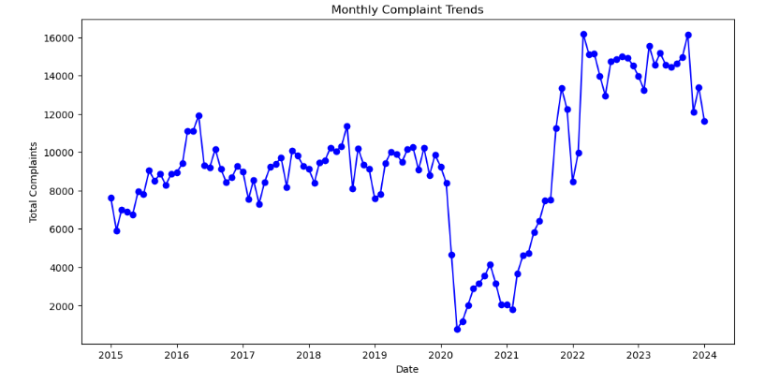
Monthly Complaint Trends Visualization Type: Trend Line Data Source : complaints-by-airport.xlsx
Here’s a breakdown of the insights:
Monthly Complaint Trends: The line shows fluctuations in total complaint volume from month to month, allowing stakeholders to identify specific periods with noticeable increases or decreases in complaints.
Seasonal and Periodic Patterns: Peaks or dips in the trend line may reveal seasonal patterns or periodic spikes, possibly linked to high travel seasons, holidays, or specific operational issues. For example, a consistent rise during summer months could indicate higher complaint volumes during peak travel.
Data-Driven Strategy: By visualizing complaint trends, this chart highlights the need for proactive measures during high-complaint months. This can aid in resource allocation, staff training, and policy adjustments aimed at minimizing complaints during anticipated busy periods.
Engagement-Friendly Design: Using a clean line with markers for each data point ensures clarity and readability, helping viewers grasp trends quickly. The blue color provides a neutral, professional tone, guiding attention without distraction.
Overall, this visualization gives a clear, time-based overview of complaint trends, supporting data-driven strategies to improve passenger satisfaction and operational efficiency during critical periods.

Slide 8
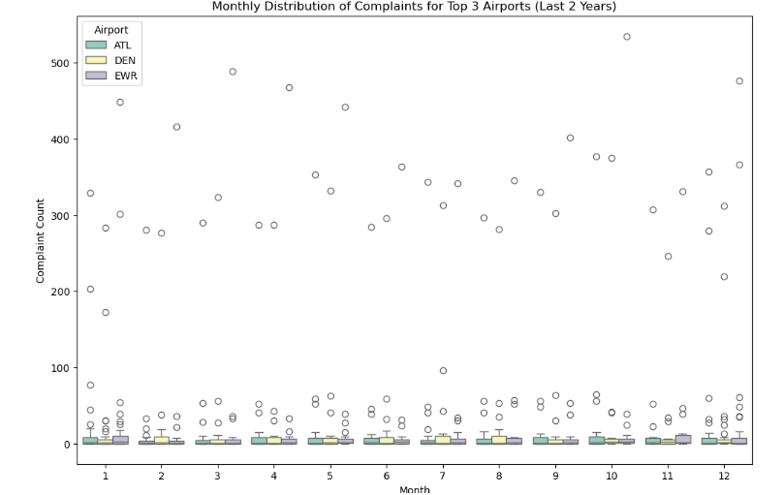
Monthly Complaint Trends Visualization Type: box plot Data Source : complaints-by-category.xlsx
The following insights emerge from the visualization:
Monthly Variation in Complaints: Each month’s box represents the range and distribution of complaints received. This view highlights not only the average complaint count but also the variability, including any outliers (extremely high or low complaint counts) that may warrant attention.
Comparative Analysis Across Airports: By color-coding each airport, the plot makes it easy to compare complaint trends across the three busiest airports. For instance, one airport may consistently have higher complaint counts in certain months, revealing where service improvement efforts might be prioritized.
Identification of Peak Complaint Months: Months with higher medians or wider distributions point to potentially challenging periods for customer service, possibly tied to seasonal travel patterns or operational challenges.
Operational Insights: This visualization supports airport management teams in identifying which months see the most variation in complaints and which airports are consistently high in complaints, guiding data-driven decisions in staffing, resource allocation, and training.
Overall, this chart serves as a clear, insightful tool for understanding complaint patterns, supporting targeted interventions that can improve passenger experience during critical travel periods.

Slide 9
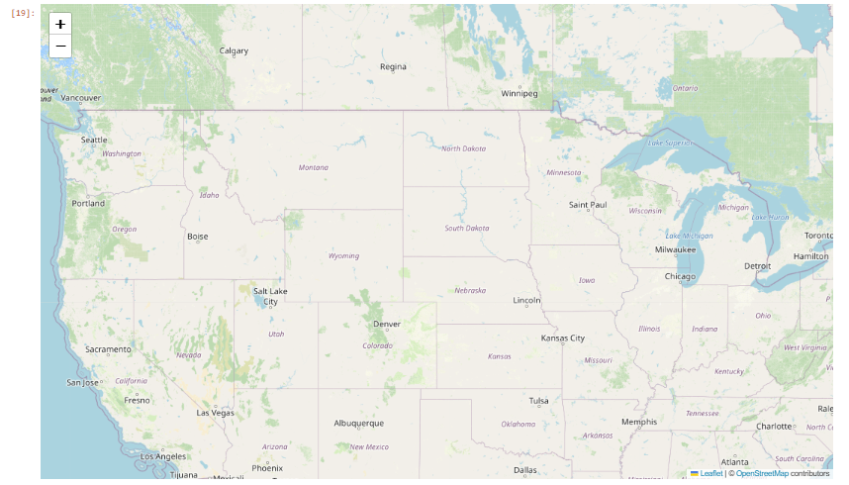
Top 10 airports Visualization Type: Heat Map Data Source : iata-icao.xlsx
The key aspects of the visualization are as follows:
Heat Map Layer: The heat map layer provides a color-coded density visualization based on the total number of complaints for each airport. Areas with warmer colors (e.g., yellow or red) indicate higher complaint volumes, while cooler areas (green or blue) represent lower volumes. This layer visually emphasizes regions with more passenger issues, helping to quickly identify hotspots of high complaint activity.
Top 10 Airports Highlighted with Markers: Each of the 10 airports with the most complaints is marked with a red icon. Clicking on any marker reveals a pop-up showing the airport's name and the total complaint count. These markers serve as focal points for decision-makers to identify specific airports requiring targeted improvements in operations or passenger service.
Geographic Context: By using a U.S.-centered map with airport locations overlaid, the visualization gives insights into regional patterns in passenger complaints, revealing whether specific areas (e.g., densely populated or high-traffic regions) consistently see higher complaint volumes.
Intuitive User Interaction: With an interactive map format, users can zoom in and out to focus on particular regions, adding a layer of flexibility for viewers to explore specific areas of interest in more detail.
This visualization effectively combines both density and specific location data, providing a comprehensive view of passenger complaints across the country and allowing for actionable insights at the most problematic airports.

Slide 10
Thanks !!!

